Slide 1
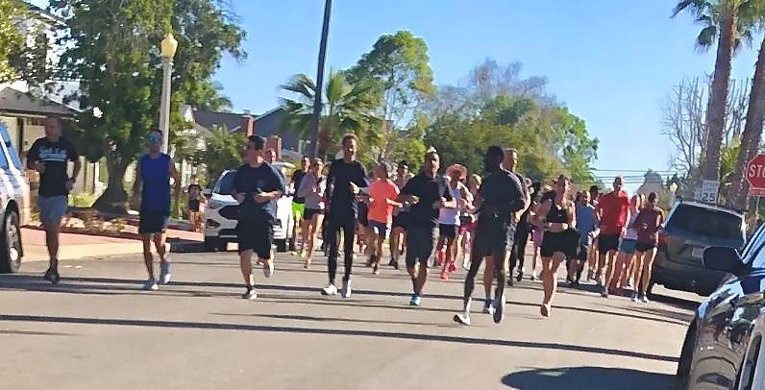
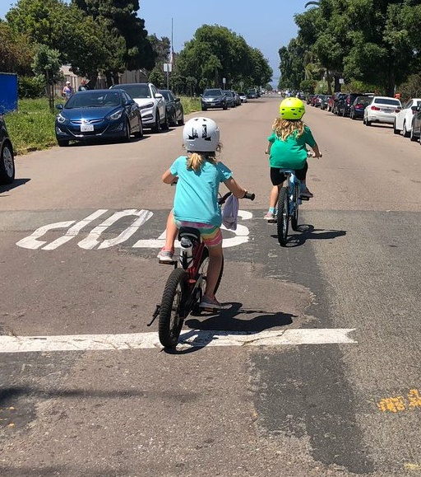
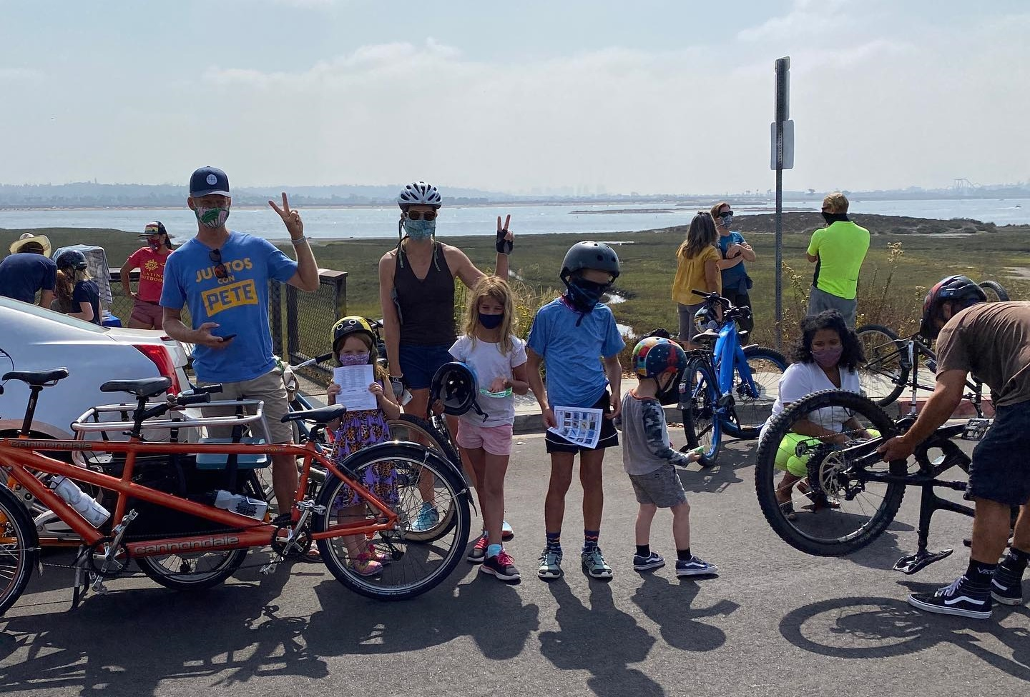
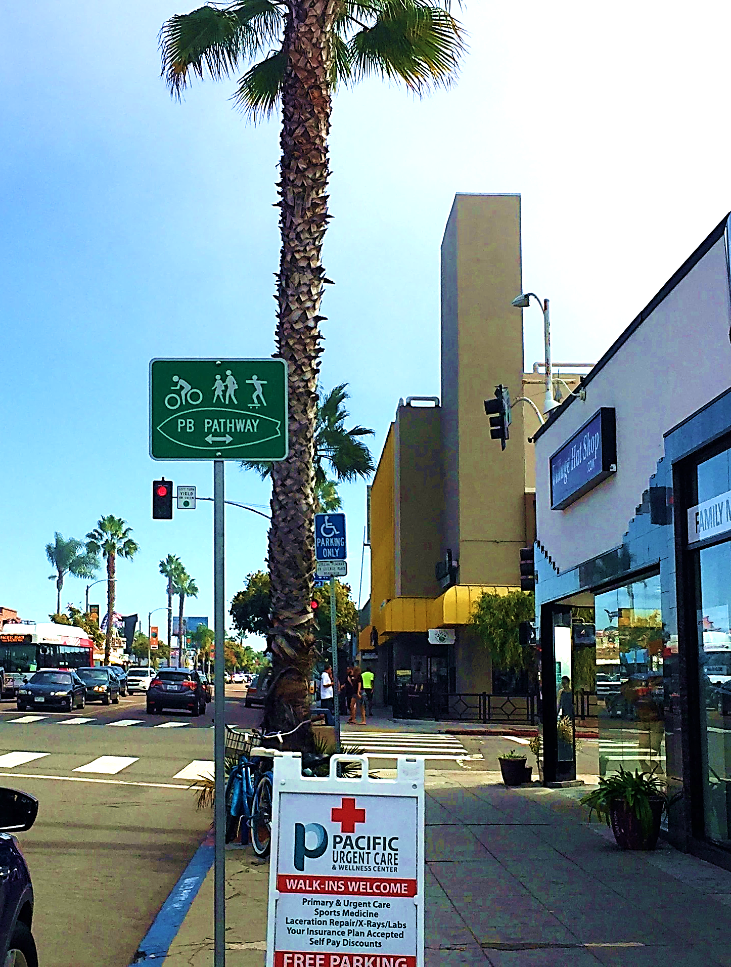
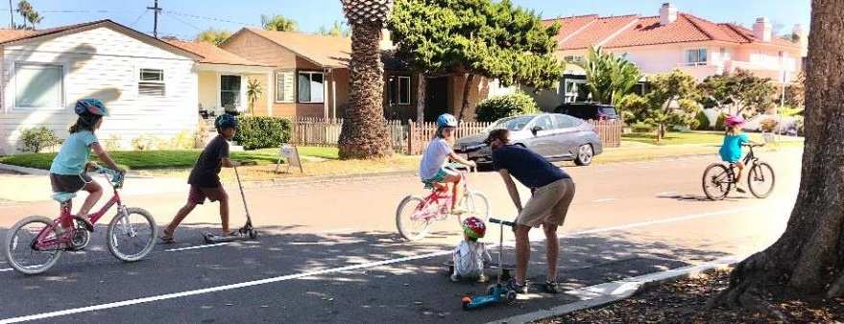
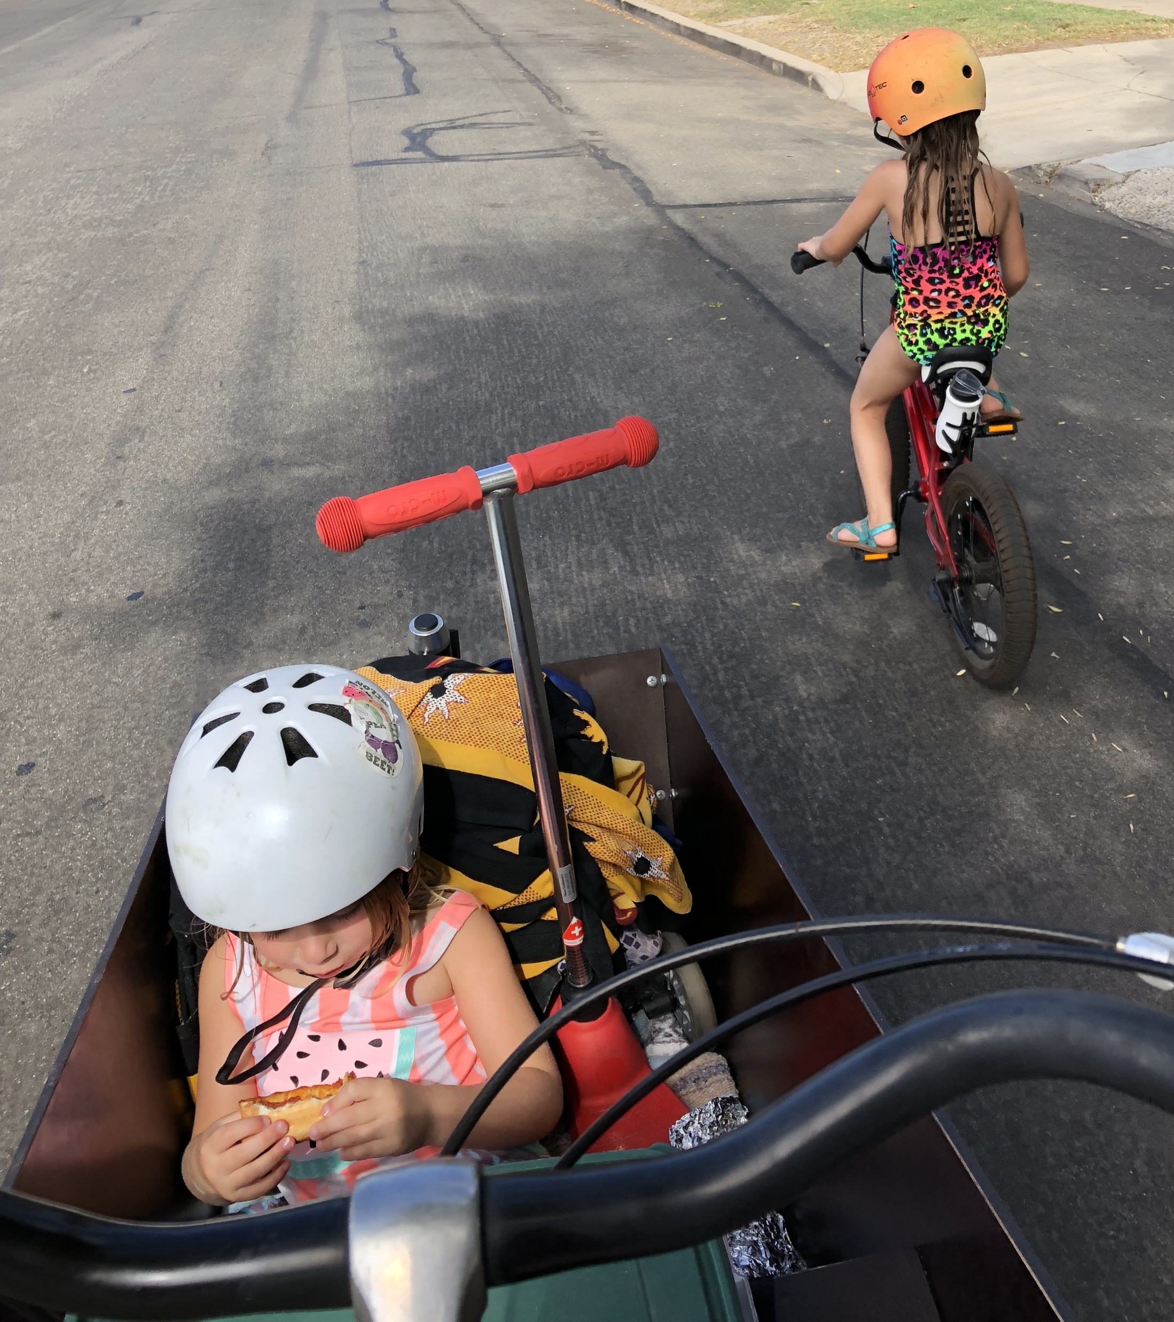
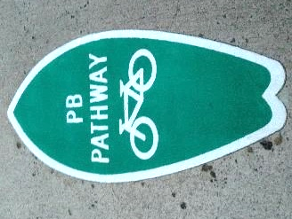
PB Pathways
PBPG March 13, 2022

Slide 2
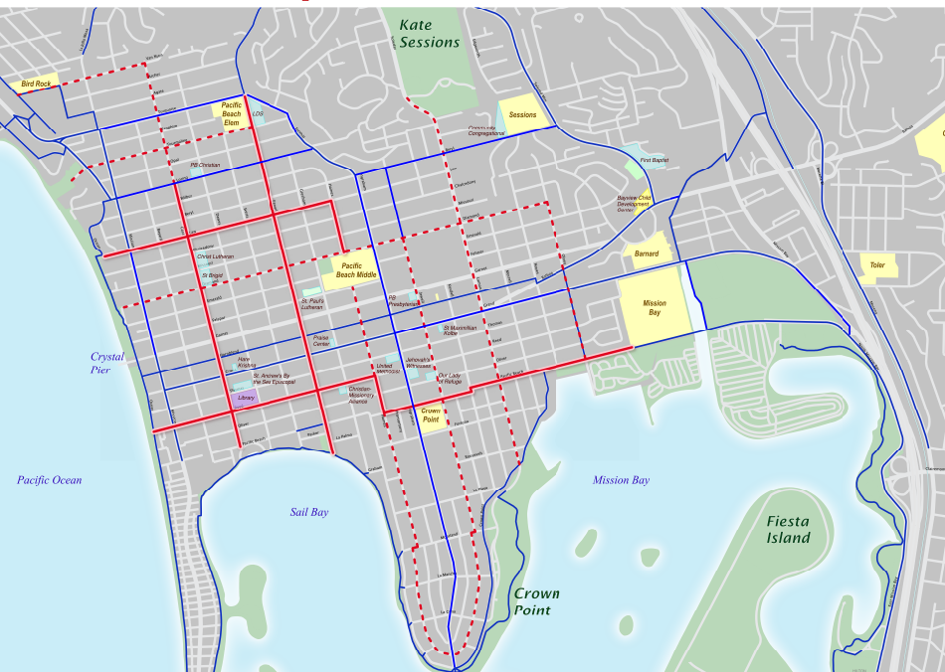
PB Pathways Network
Van Nuys
Local travel
Active transportation
Walking, biking, skating, scooting, & more
Allow driving
Tourmaline
Law
Jewell
Lamont
Olney
Grand
Fanuel
Cass
PB Drive
Reed
Ingraham
Phase 1
Future Phase(s)
Regional Bicycle Routes

Slide 3
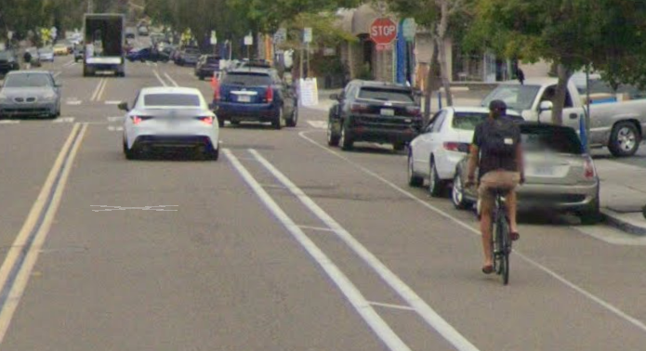
History
Van Nuys
2014
PB Pathways network created
Tourmaline
2015
Phase 1 improvements
Law
Jewell
Lamont
Olney
Wayfinding signs
Surfboard decals
Curb ramps
Enhanced crosswalks
Grand
Fanuel
Cass
PB Drive
Reed
2016
Cass St. bike lanes
Ingraham

Slide 4
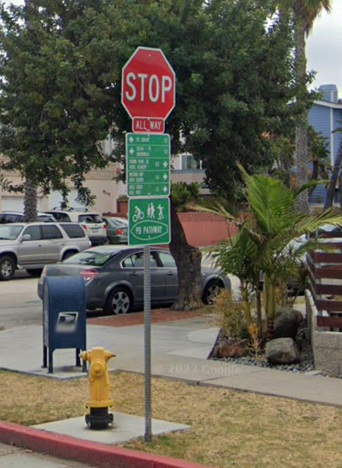
Purpose
Link different parts of neighborhood
Guide visitors to local destinations
Support multiple transportation options
Build community connections & identity
Improve traffic safety

Slide 5
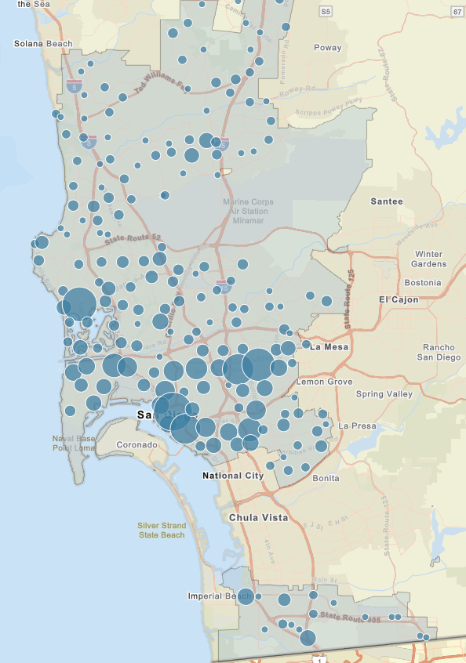
City of San Diego
Severe or fatal pedestrian/bicycle crashes 2012-2022

Slide 6
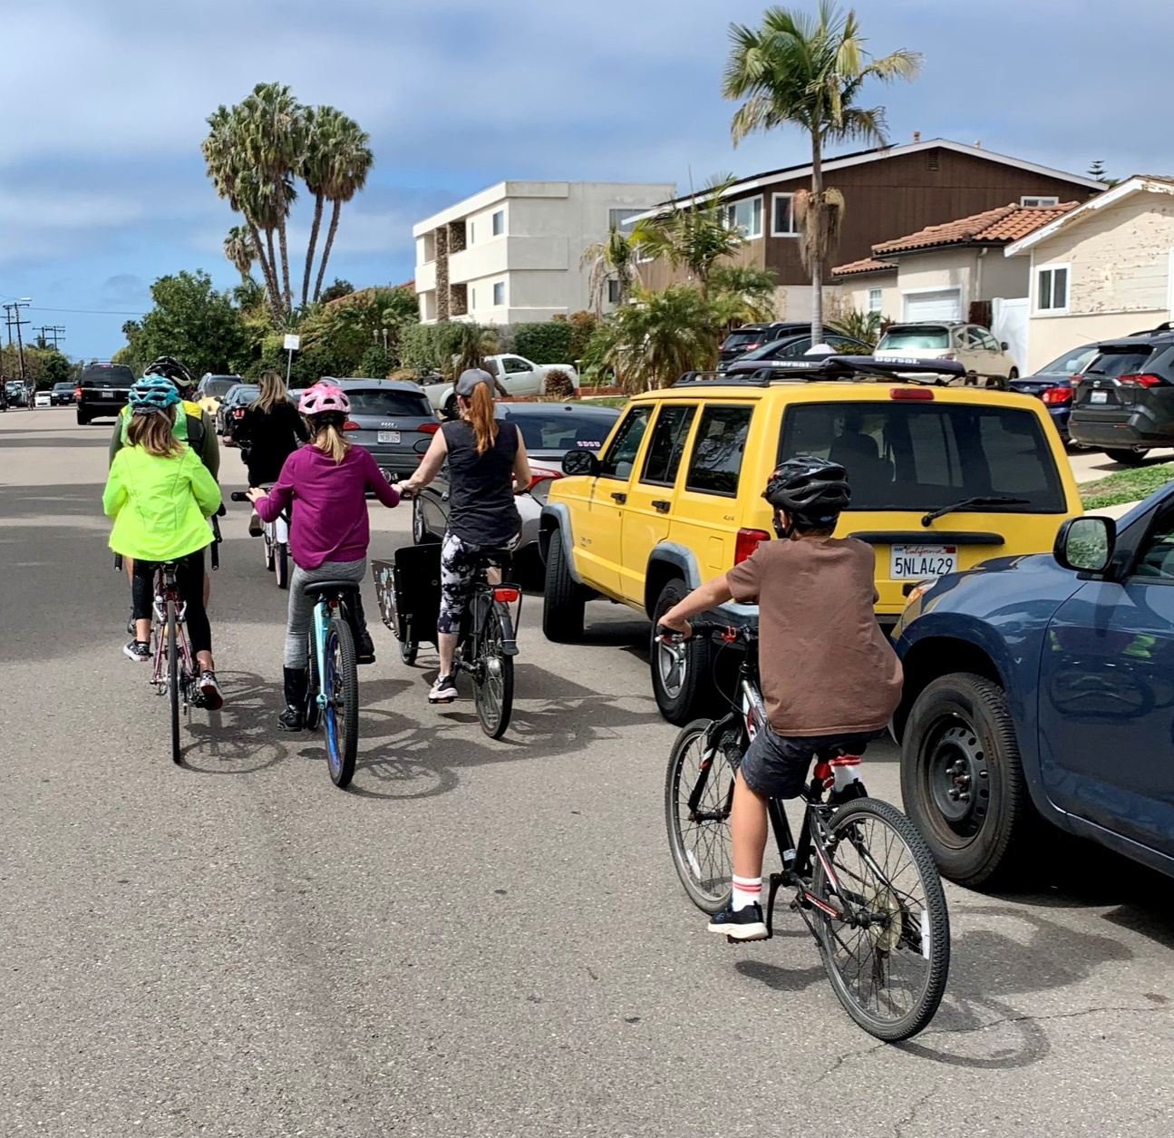
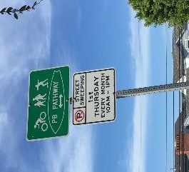
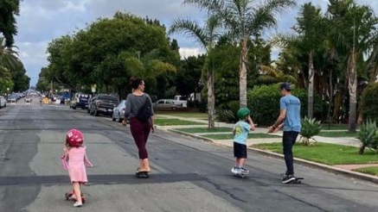
Current Status and Next Steps
Phase 1 complete
Damage/repaving to in-road decals
CPD Pathways Ad-Hoc Subcommittee
Prioritize routes for next phase
Identify potential interventions
Diamond St Slow Street
Monthly meetings on fourth Monday
Next Meeting March 25, 6-7:30 pm at library

Slide 7
PB Pathways Network
Van Nuys
Tourmaline
Law
Jewell
Lamont
Olney
Grand
Fanuel
Cass
PB Drive
Reed
Ingraham
Phase 1
Future Phase(s)
Regional Bicycle Routes

