Slide 1
PBPG Update – August 22, 2012
Code Compliance:
July 9th Meeting action item update
August 13th Meeting Canceled
Electronic Media:
Legacy Website Changes
Electronic Media – New Website Development

Slide 2
NCC – July 9th 2012 Meeting Highlights
Agenda Items
Tokyo house deck – PROW Compliance - Action to pull permit from public records and report back at next subcommittee meeting (JN)
Code Compliance Violation Letters – PBPG response recommendation – Subcommittee voted to stand by on response to the letters until we make contact with a city code compliance rep to address the board about the intent of the ordinance. Once date confirmed recommend responding with invitation to PBPG meeting. (LE)

Slide 3
NCC – July 9th 2012 Meeting Highlights (con’t)
Standing Actions update:
Development of form letters and educational material – no additional progress has been made. This remains an outstanding item.
Contact of City Code Compliance rep – Email sent without response. Will continue to attempt contact via telephone.

Slide 4
NCC – July 9th 2012 Meeting Highlights (con’t)
Non-Agenda items:
News Paper Racks – Action steps taken to begin addressing a communicated concern over nuisance curbside news paper racks (JS)
Identified the city ordinance on News Paper Racks – in accordance with this ordinance have initiated steps in the following actions:
Inventory all News Paper Racks in PB – Initiated using Google Map Markers.
Perform permit check for all identified racks
For all non-permitted racks pursue removal under city ordinance
For permitted racks perform physical inspection and photo documentation to identify any racks that are not in compliance with the city ordinance deeming them “Nuisance”.
For all Nuisance Racks pursue city to revoke permits and remove Racks.
NCC – Priority List – During next subcommittee meeting will tailor a PBPG NCC Priority list based on the City’s priority list to bring to the board for approval (JS)

Slide 5
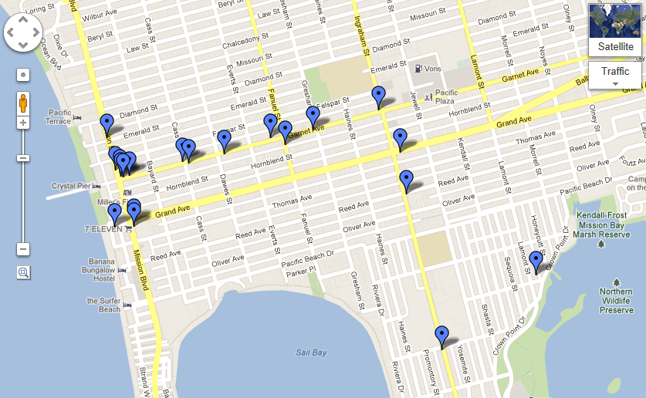
News Rack Inventory - Partial inventory

Slide 6
Electronic Media New Website Development
Development of a new PBPlanning.org website is currently under way
Development of new site is being conducted on the Legacy host at http://new.pbplanning.org/
New website will be role based and will allow for Subcommittee Chairs to maintain their own pages.
Requesting Board/Public to submit requests for possible site features to Baylor Triplett. We will evaluate these for feasibility and plan to allow the board to vote on a final set of features.
Will develop a detailed User Guide and Administration Guide upon completion of the site.

Slide 7
Electronic Media Legacy Website
The Legacy website is still being maintained
Have re-organized the site content to put the Monthly Board Meeting agenda’s and project files from the agenda on the front page under one post.
Menu structure has changed to keep information organized in a logical manner.
Changed photos at the request of the public
Addressed Ownership issue – the site is now registered to a Planning Board Member.

Slide 8
Electronic Media New Website Development
Next Steps / Advanced Site Development:
Continue development of advanced site UI.
Develop User Interface Controls that will allow for role based access which will create a simple and consistent user experience.
Develop Calendar Widget
Collect new content from the board i.e Bio’s, images, subcommittee info, calendar info.
Develop User Guides for each class of user:

Slide 9
Electronic Media Social Media
Linkedin – PBPG Linkedin Group:
http://www.linkedin.com/groups/Pacific-Beach-Planning-Group-4441641/about
Facebook – PBPG Page:
http://www.facebook.com/#!/PBPlanning

Slide 10
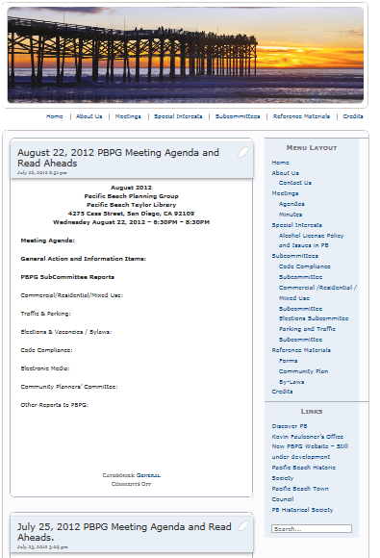
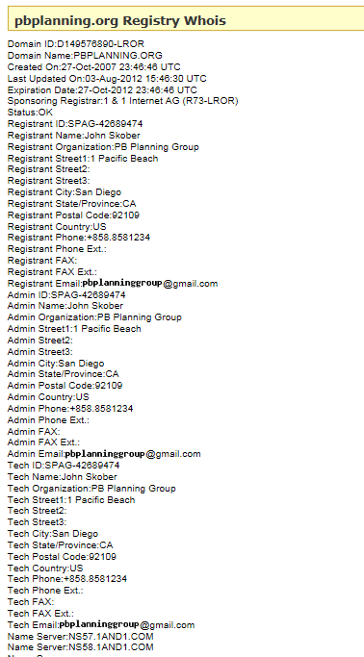
Legacy website re-structuring and Registered Owner

