Slide 1
Foothill Blvd & Loring Street Roundabout
Pacific Beach Planning Group
May 13, 2020

Slide 2
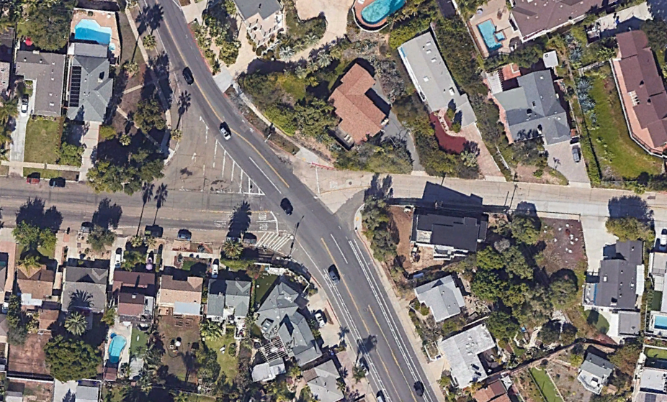
Public Works Department
Source: Google Earth
2

Slide 3
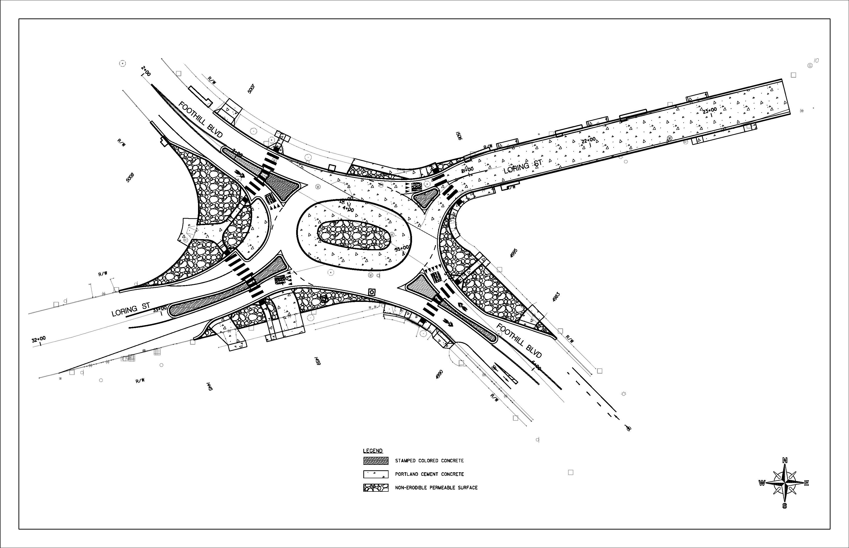
Public Works Department
3

Slide 4
Public Works Department
Project Scope
Traffic Calming features
Roundabout
Raised Splitter Islands with Passageways
Truck Aprons
Curb Extensions
ADA Improvements
Sidewalk
Curb Ramps
Roadway Improvements
Street Resurfacing
Concrete Street Replacement
Continental Crosswalks
Curb and Gutter
Driveways
Drainage Improvements
7 New Curb Inlets
640 feet of Storm Drain Pipe
Streetscape
Stamped Concrete
Water Quality
Non-Erodible Permeable Surface (Cobble)
Biofiltration Unit
Existing Bridge
Proposed Bridge
4

Slide 5
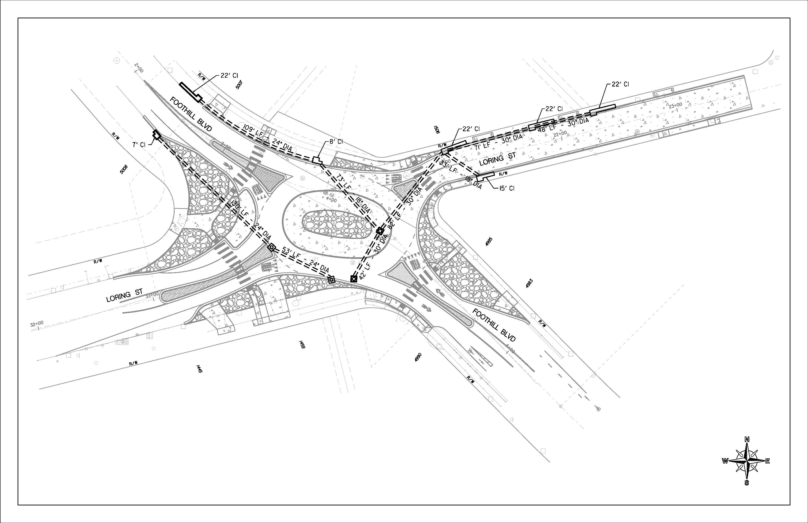
Storm Drain Improvements
Proposed Improvements
106 LF of 18-inch Pipe
292 LF of 24-inch Pipe
243 LF of 30-inch Pipe
7 Inlets
4 Cleanouts
5

Slide 6
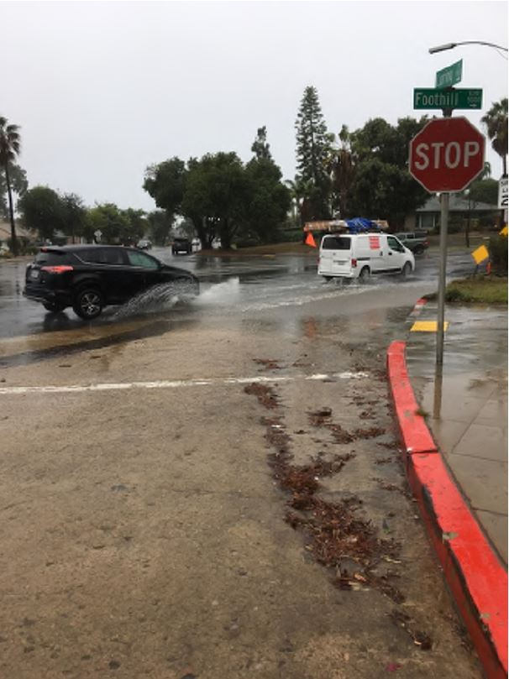
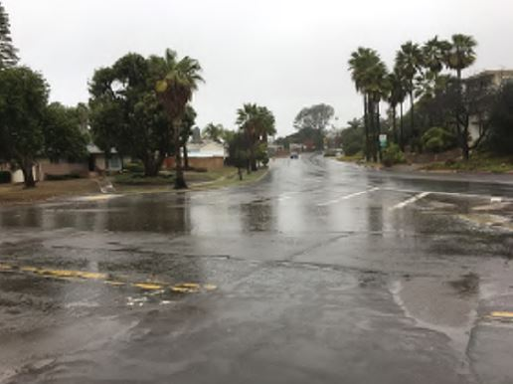
Public Works Department
Foothill Blvd looking West
NE side of Foothill Blvd and Loring St
Existing Bridge
Proposed Bridge
6

Slide 7
Public Works Department
Project Schedule & Budget
Schedule
Start Construction: Fall 2021
End Construction: Fall 2022
Current Status: Design
Budget
Estimated Construction Cost: $1,800,000
7
Notes:
Fund Sources
Sea World Traffic Mitigation
Proposition A
Transnet
Highway Bridge Program (Federal Grant)
Local Advance Construction (AC): Encumbrance policy

Slide 8
Public Works Department
Questions?
Thank you!
8

